Slide 1


Slide 2
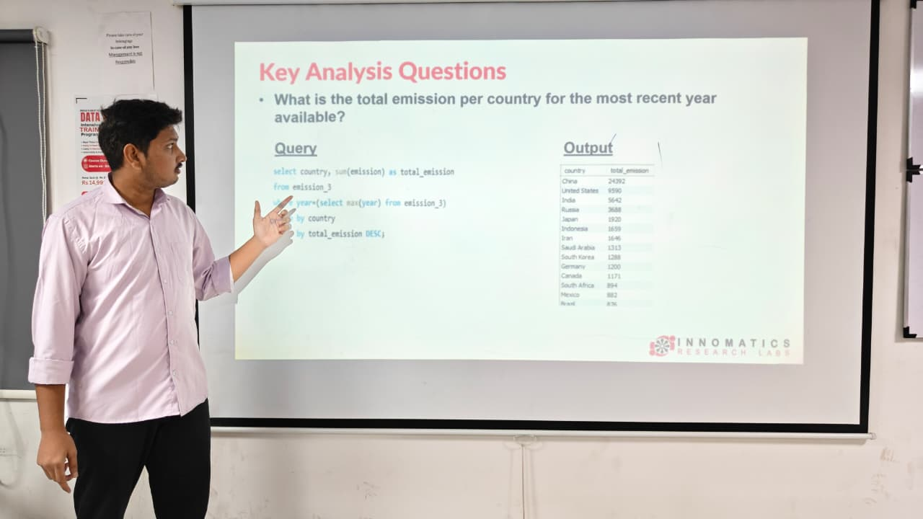

Slide 3

World Wide Energy Consumption Analysis
Presented By:
Parvez Shaik

Slide 4
About me
Name : Parvez Shaik
Education : B.Tech (CSE)
Linkedin : https://www.linkedin.com/in/parvezshaik2703/
GitHub : https://github.com/parvezsk2703

Slide 5
Agenda
Introduction to Dataset
Objective of the Project
Dataset Overview
ER Diagram
Key Analysis Questions
SQL Analysis & Findings
Insights & Conclusion
Challenges Faced

Slide 6

Objective of the Project
The goal of this project is to analyze global energy data to understand the relationship between:
Energy Consumption
Energy Production
GDP
Population
Emissions
Using SQL queries, the project aims to identify trends, comparisons, and environmental insights across countries.

Slide 7

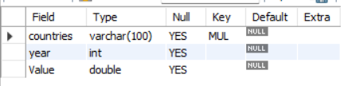
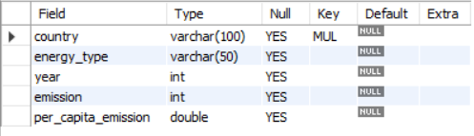
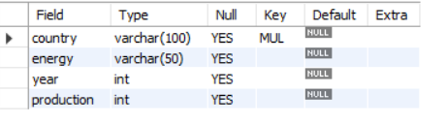
Tables Description
1) Country Table
3) Population Table
2) Emission Table
4) Production Table

Slide 8
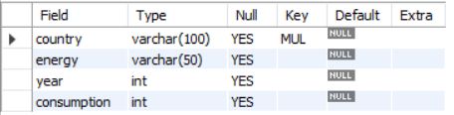
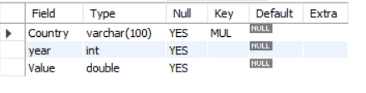
5) Consumption Table
6) GDP Table

Slide 9
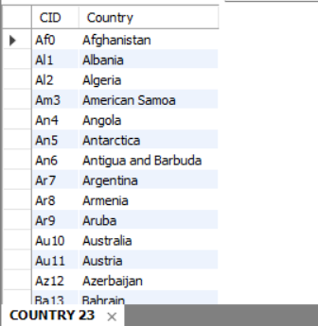
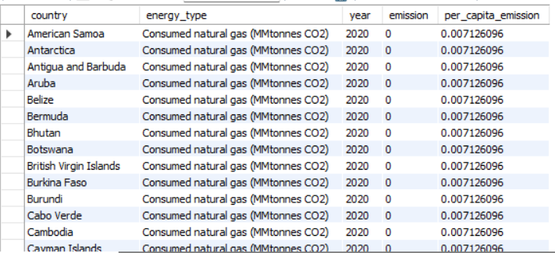
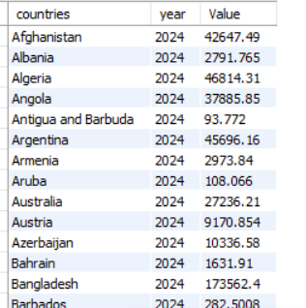
Table Structure
1) Country Table
2) Emission Table
3) Population Table

Slide 10
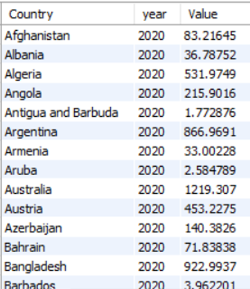
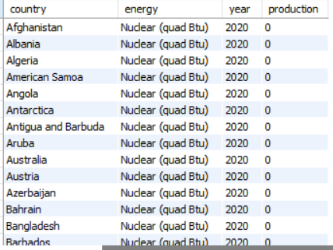
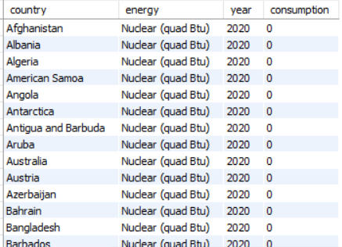
4) Production Table
5) Consumption Table
6) GDP Table

Slide 11
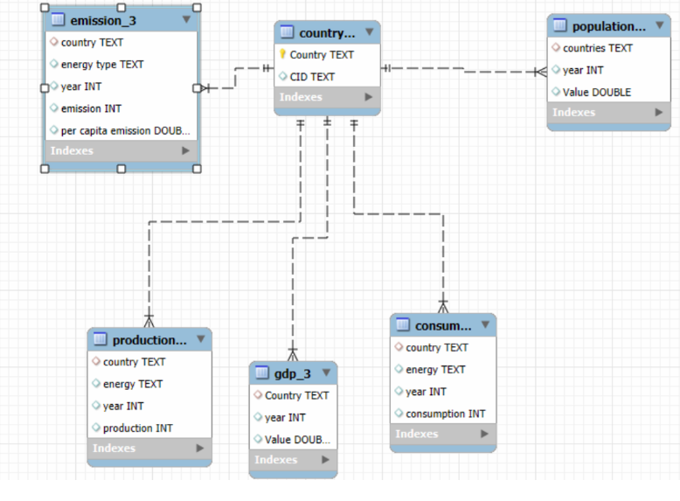
ER Diagram
The country table acts as the central table, and other tables are connected using foreign key relationships forming a one-to-many relationship.

Slide 12
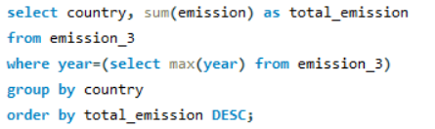
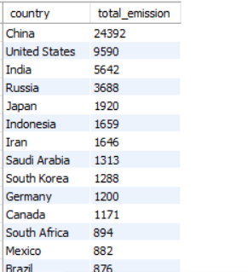
Key Analysis Questions
What is the total emission per country for the most recent year available?
Query
Output

Slide 13

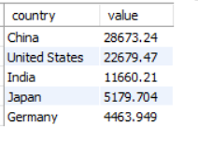
What are the top 5 countries by GDP in the most recent year?
Query
Output

Slide 14
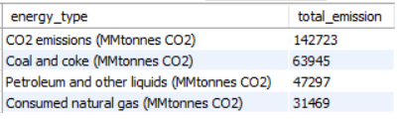
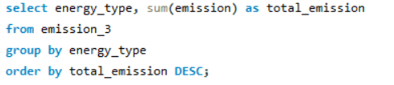
Which energy types contribute most to emissions across all countries?
Output
Query

Slide 15
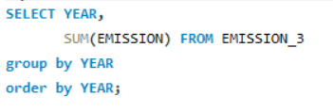
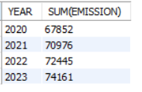
How have global emissions changed year over year?
Query
Output

Slide 16
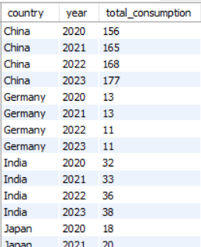
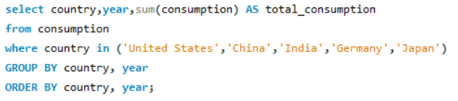
Has energy consumption increased or decreased over the years for major economies? (US, China, India, Germany, Japan)
Query
Output

Slide 17
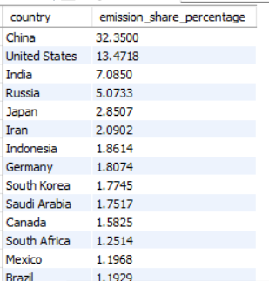
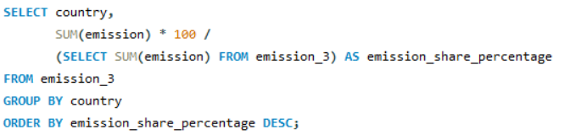
What is the global share (%) of emissions by country?
Query
Output

Slide 18
Key Insights
▪ Global energy consumption has increased over the years, driven by population growth and economic development.
▪ China, the USA, and India contribute a major share of global energy use and emissions, highlighting their influence on global energy trends.
▪ Fossil fuels remain the dominant energy source, making them the primary contributors to global emissions.
▪ Countries with higher GDP generally show higher energy consumption, indicating a strong link between economic growth and energy demand.
▪ Population growth significantly impacts emissions, as larger populations require more energy for industrial and domestic activities.

Slide 19
Recommendations
Promote renewable energy sources such as solar and wind to reduce reliance on fossil fuels.
Improve energy efficiency through modern technologies and better energy management practices.
Encourage investment in sustainable and low-carbon energy technologies for long-term environmental protection.
Use data-driven analysis of energy consumption, emissions, GDP, and population trends to support better decision-making.
Strengthen international cooperation to share best practices and improve global energy sustainability.

Slide 20
Conclusion
Energy consumption and emissions are higher in major economies due to population growth and industrial development.
Fossil fuels are still the main energy source, leading to higher global emissions.
Energy demand increases as population and economic growth increase.
Some countries use energy more efficiently, producing lower emissions compared to others.
Using renewable energy and improving efficiency can help reduce emissions and support sustainable development.

Slide 21


